Slide 1

AirBNB Data Analysis
DETAILED PROJECT REPORT
AKHIL K N
USHA YADAV

Slide 2
PROJECT DETAIL
Project Title | AirBNB Data – Analysis
Technology | Business Intelligence
Domain | Business Analytics
Project Difficulty level | Advanced
Programming Language Used | Python
Tools Used | Jupyter Notebook, MS-Excel, MS-Power BI

Slide 3
OBJECTIVE
The aim of this project is to analyze Airbnb's 2019 San Diego listings by examining key metrics and host behaviors, to predict trends and draw insights about the short-term rental market in the region.

Slide 4
PROBLEM STATEMENT
Since 2008, Airbnb has transformed the way people travel by offering guests and hosts a platform to explore diverse and personalized accommodation options. This dataset provides detailed insights into Airbnb's listing activities and key metrics for San Diego, California, for the year 2019.
The dataset contains essential information for understanding host profiles, geographical distribution of listings, and other important metrics. With 18,723 rows and 19 columns, it includes comprehensive data necessary for making predictions and drawing meaningful conclusions about the short-term rental market in San Diego.

Slide 5
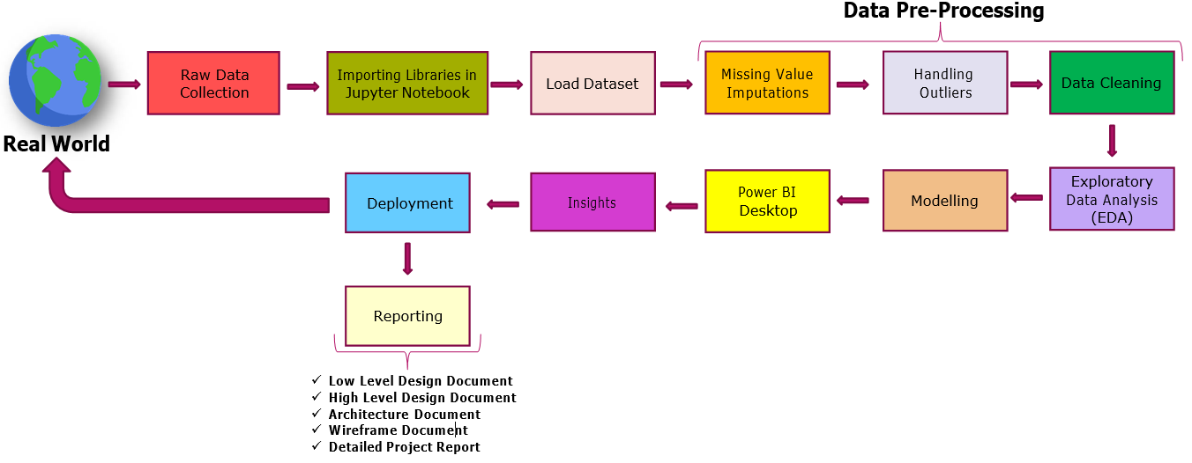
ARCHITECTURE

Slide 6
DATASET COLUMN DETAILS
room_id : ID of the room.
survey_id : ID of the survey.
host_id : ID of the host.
room_type : Type of room (e.g., Shared room).
country : Country where the room is located (seems to be empty in this case).
city : City where the room is located (e.g., Amsterdam).
borough : Borough or district within the city.
neighborhood : Neighborhood within the borough.
reviews : Number of reviews the listing has received.
overall_satisfaction : Overall satisfaction rating (e.g., 4.5, 5).

Slide 7
accommodates : Number of people the room can accommodate.
bedrooms : Number of bedrooms in the listing.
bathrooms : Number of bathrooms in the listing.
price : Price of the listing
minstay : Minimum stay required.
name : Name or description of the listing.

Slide 8
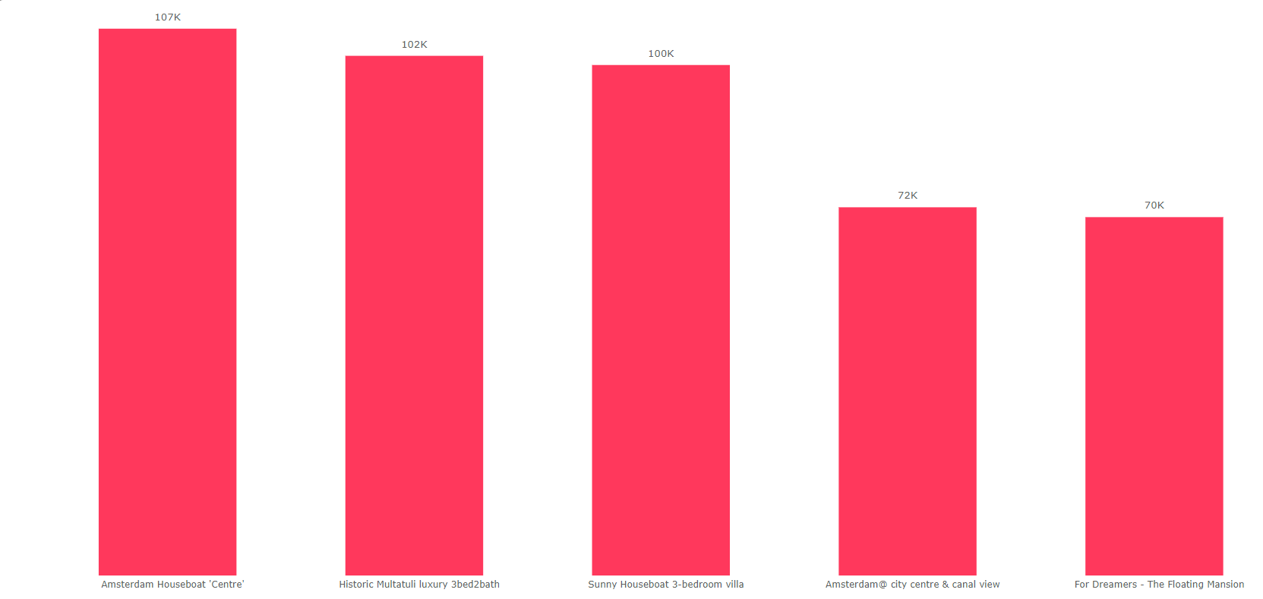
INSIGHTS FROM THE DATASET
1. Who are top earners?

Slide 9
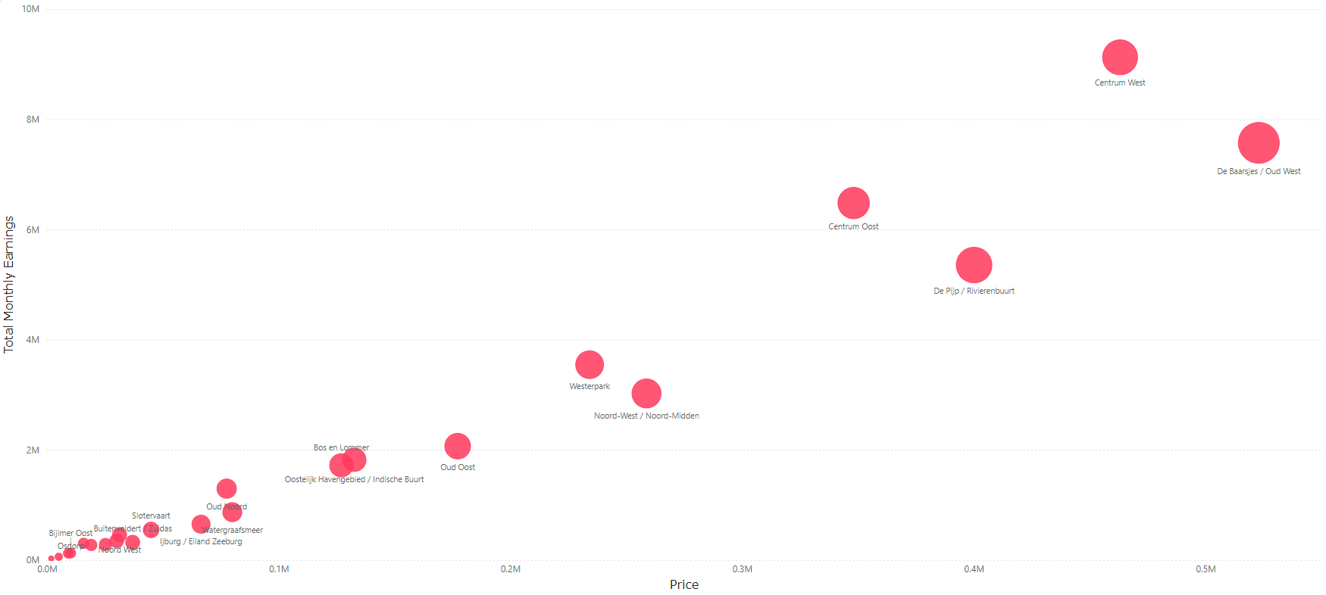
2. Is there any relationship between monthly earning and prices?

Slide 10
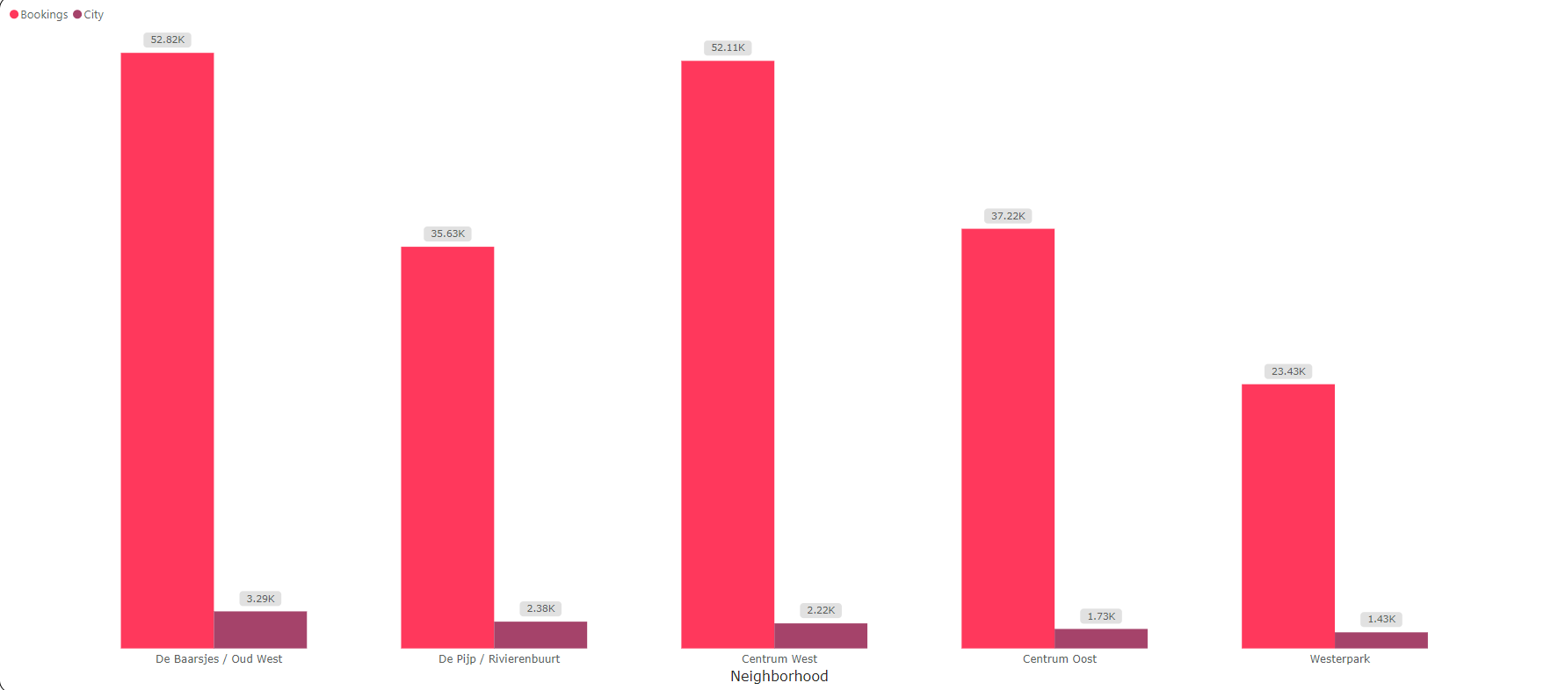
3. Any particular location getting maximum number of bookings?

Slide 11
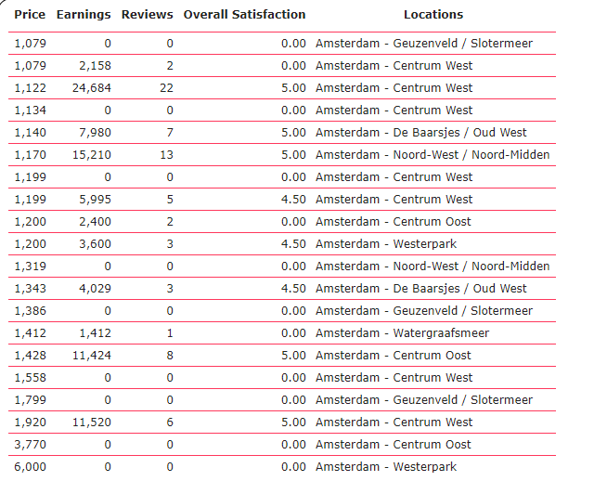
4. Price relation with respect to location?

Slide 12
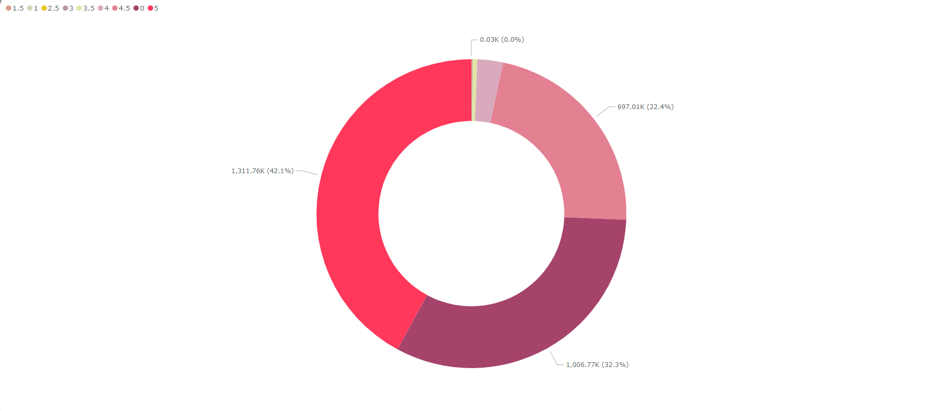
5. Relationship between Quality and Price?

Slide 13
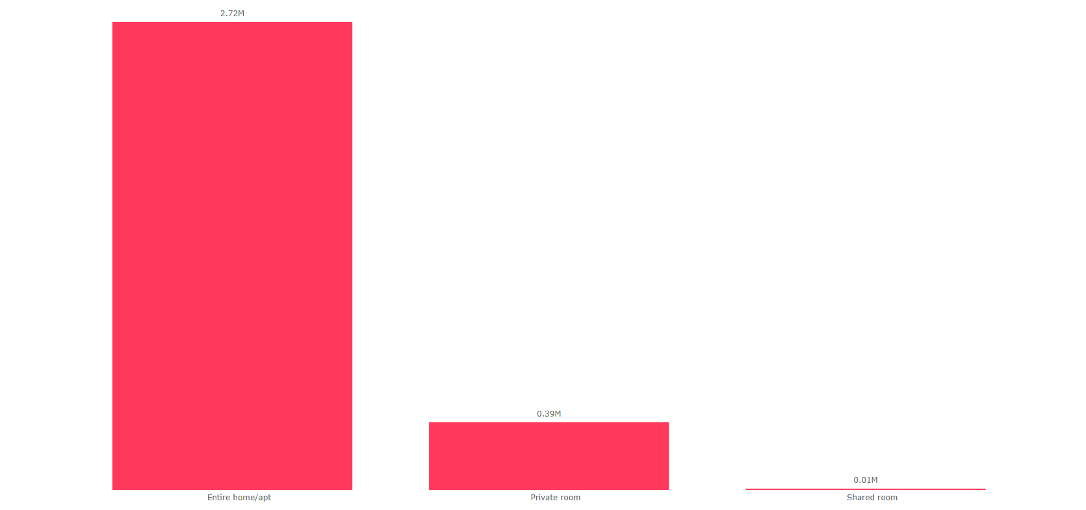
6. Price vs amenities?

Slide 14
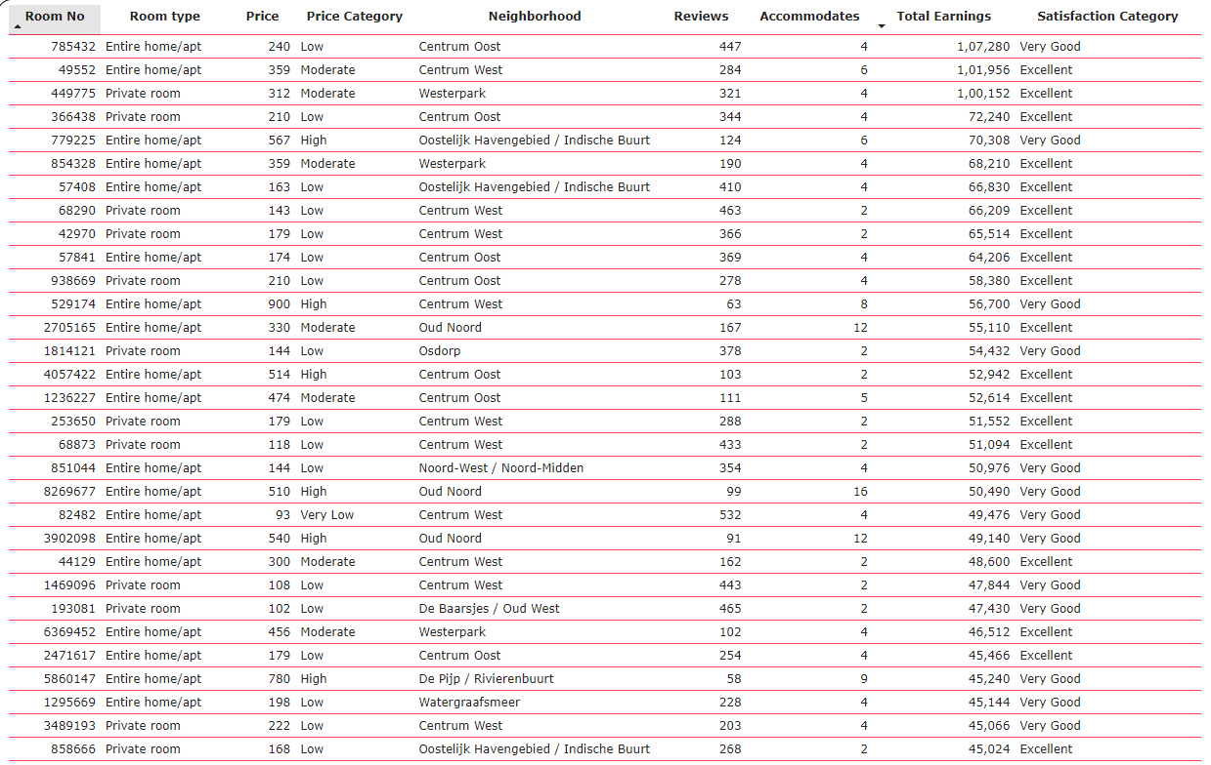
7. Price vs location.

